Slide 1
Housing in HK: HOS Analysis
Group 4
Xccelerate – Data Science Stream (March 2021)

Slide 2
Content
Our goal
Business Value Behind
Our methods
Data collection
Data Preprocessing
Analysis
Challenges, and more
Conclusion
Q&A

Slide 3
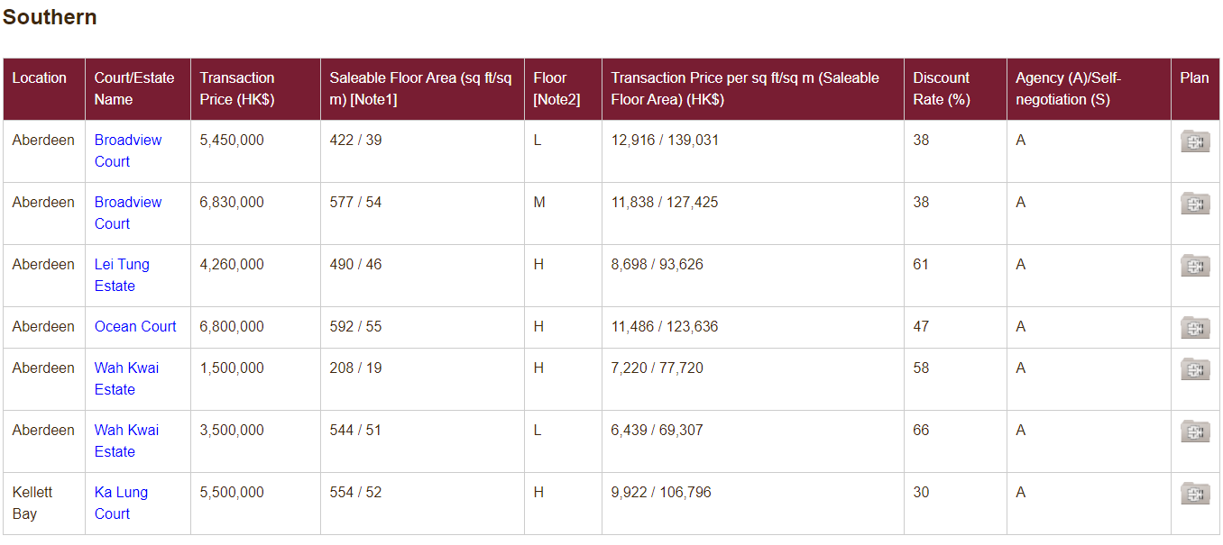
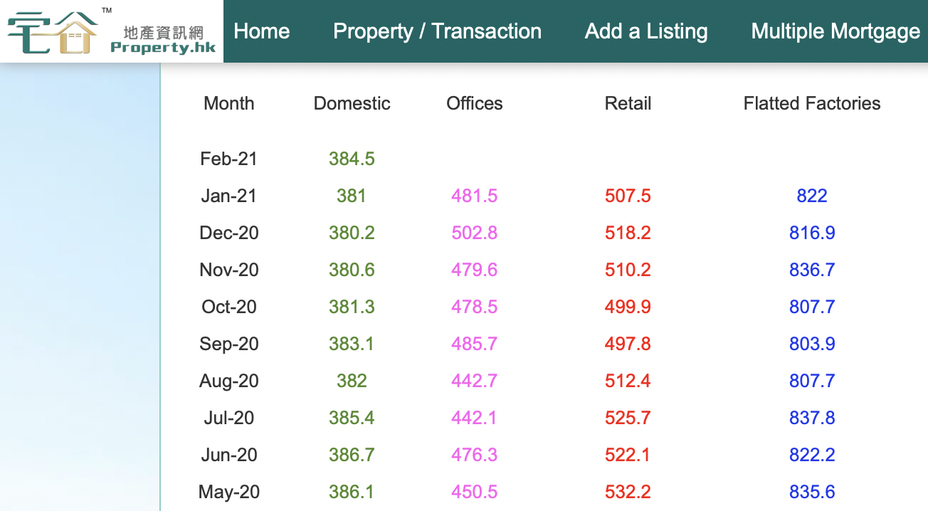
Objective
Analyse trends in Hong Kong property market
Focus on House Ownership Scheme (HOS)
Find insights and action plans from visualisation of data
Data source:
https://www.housingauthority.gov.hk/
https://www.property.hk/eng/price_indices.php

Slide 4
Business Value
Client: Housing Authority and HK citizens
Provide data analysis for HA
Transaction volume, price trend
Market information by:
location, estate
flat size
floor (high, middle, low)
Information public, good for potential buyers
Establish a simple model for projection

Slide 5
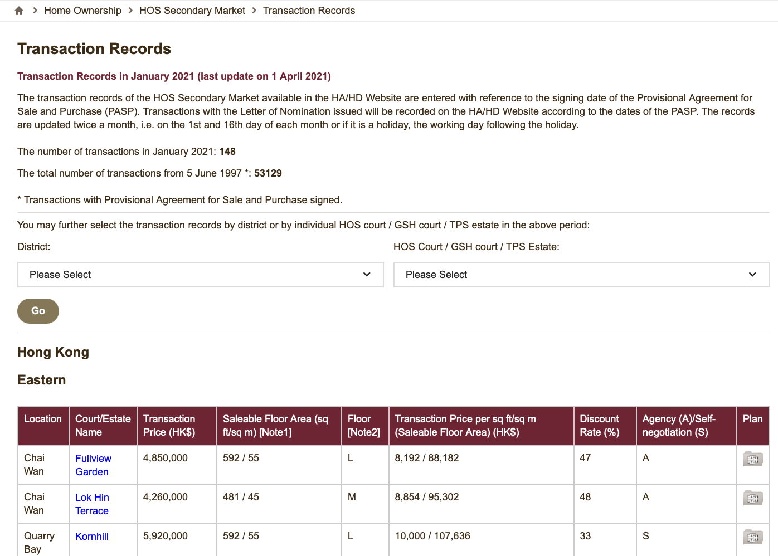
Data Collection I
Source: https://www.housingauthority.gov.hk/
Step 1: Request and parse website as HTML using Selenium and BS4
Step 2: Find all <table> <tr> and <td> elements and extract contents via get_text()
Step 3: Loop through the above process through all the months and years from 2002 (240 pages in total)
https://www.housingauthority.gov.hk/en/home-ownership/hos-secondary-market/transaction-records/transaction-records-search-detail-by-month.html?catId=1&para0=2021&para1=01

Slide 6
Data Collection II
Source: https://www.property.hk/eng/price_indices.php
Step 1: Request and parse website as HTML using Selenium and BS4
Step 2: Use a combination of <class_='col-xs-12'> and <id='tran12'>, extract contents via get_text()

Slide 7
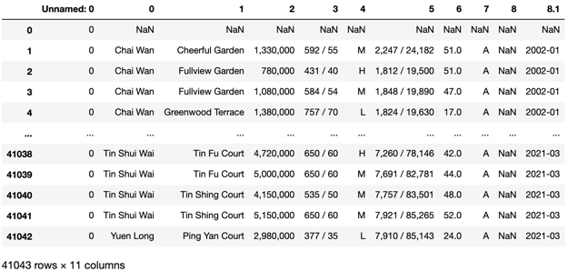
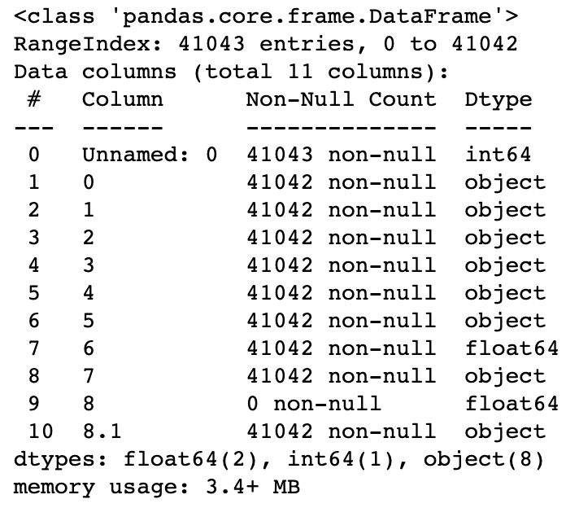
Data Preprocessing: Data Cleaning
Remove unnecessary columns
Checking for null values
Rename columns
Convert date column as datetime type and set it as index
Convert string numbers into numerical values
Check and remove duplicate values

Slide 8
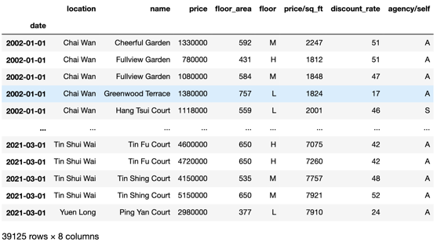
Data Preprocessing: Data Cleaning
Complete dataframe
Notes:
Note 1: 1 sq m = 10.764 sq ft.
Note 2: "H": 27/F or above; "M": 14/F to 26/F; "L": 13/F or below.

Slide 9
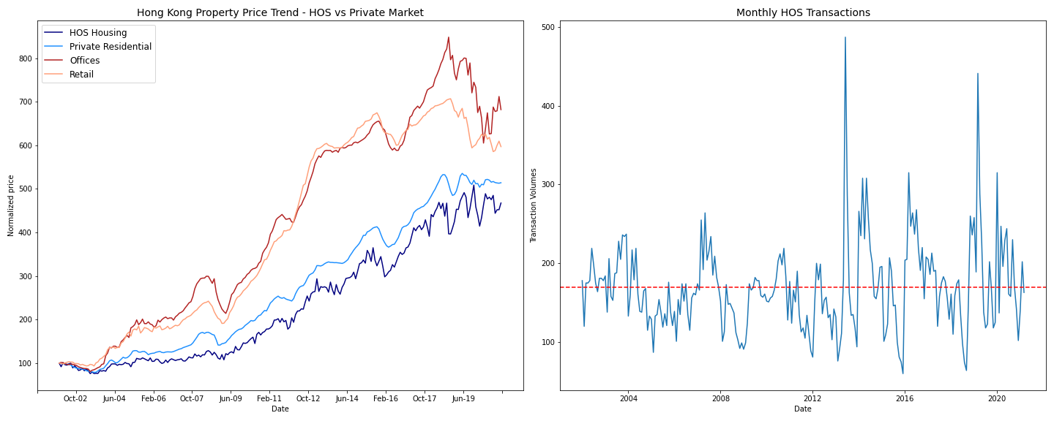
Analysis - HK Property Market Trend
OBSERVATION 1: HOS property price has increased by 395% from 2002 to date whilst transaction volumes have largely sidelined - likely a reflection of supply shortage and / or inflation rather than demand-led

Slide 10
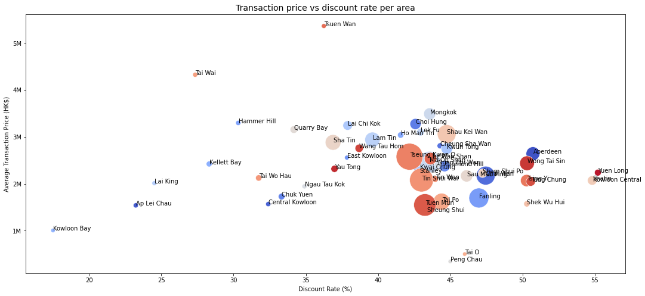
Analysis - HOS Transactions Map
OBSERVATION 2: Tseung Kwan O, Tin Shui Wan and Tuen Mun are the top locations for property purchases since 2002. Discount rate seems to be more important than price as a demand driver

Slide 11
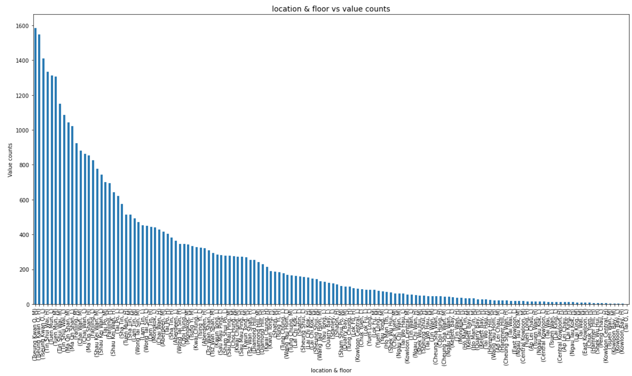

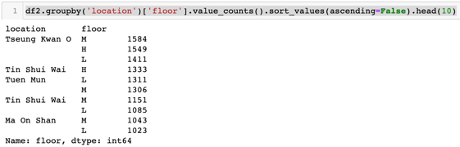
Analysis - The Most Popular Property Types
OBSERVATION 3: From 2002 to 2021, most transaction sales were made in Tseung Kwan O, Tin Shui Wai, Tuen Mun and Ma On Shan. And the floor types include all three, which are higher, middle and lower floor.
Notes:
Tseung Kwan O: 10 estates; Tin Shui Wai: 18 estates; Tuen Mun: 14 estates; Ma On Shan: 22 estates

Slide 12
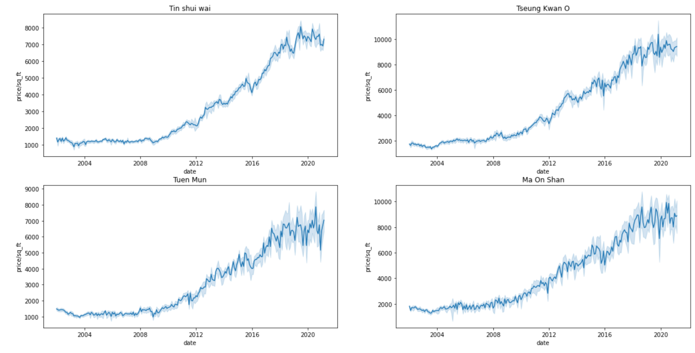
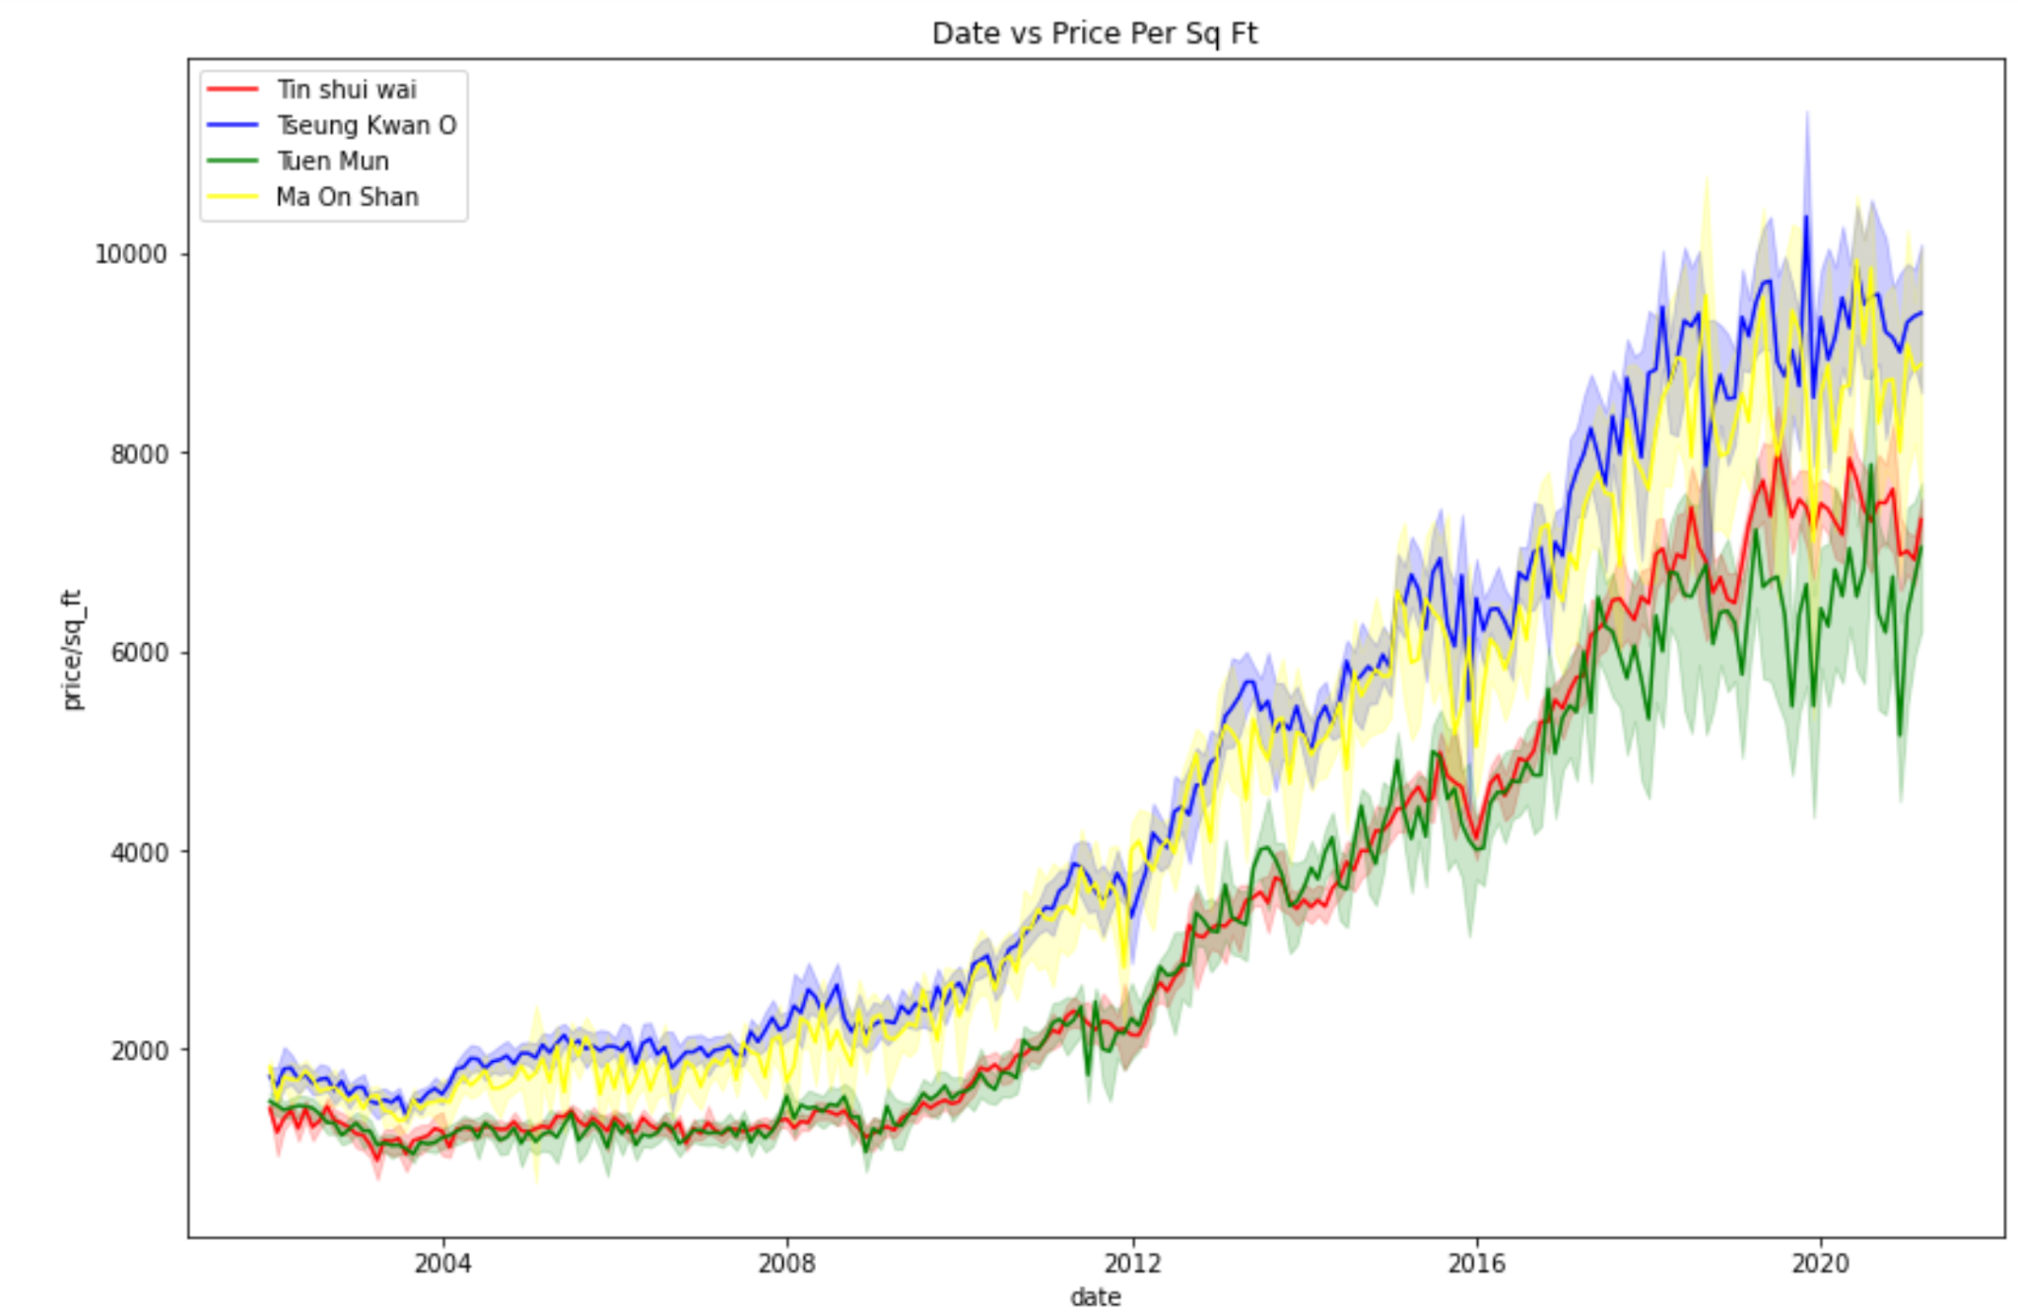
Analysis - Price per sq ft over time
OBSERVATION 4: For Tseung Kwan O, Tin Shui Wai, Tuen Mun and Ma On Shan. the transaction price per sq ft increases with time. But the increment starts to flatten around 2019.

Slide 13
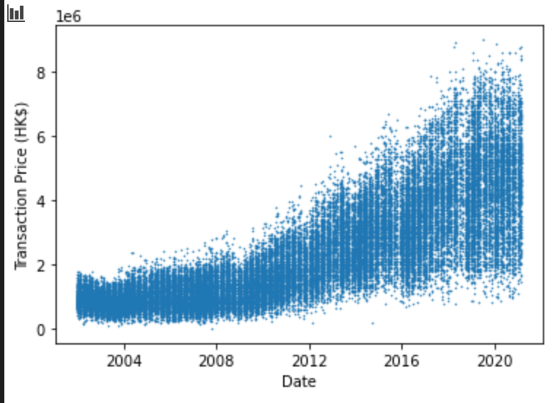
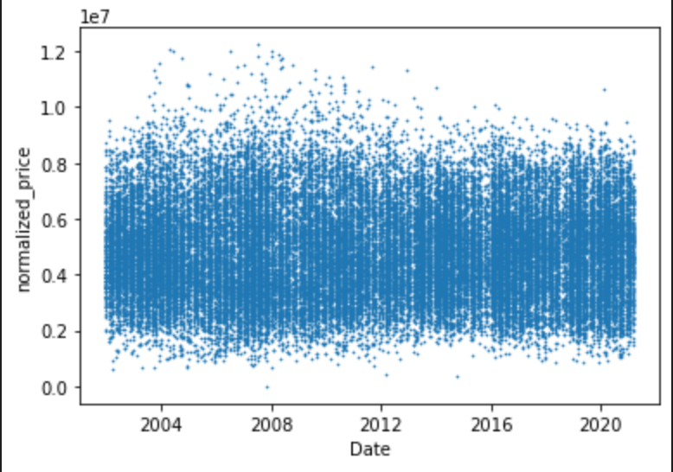
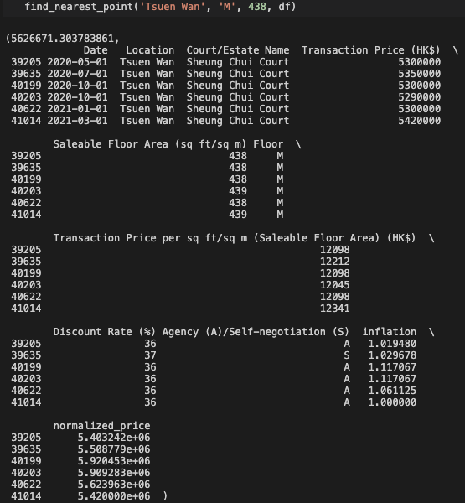
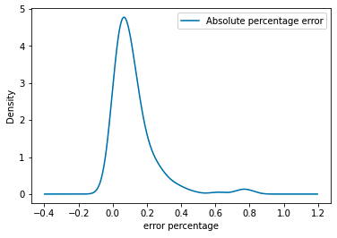
Analysis - Price Estimation
Estimate the current price of HOS properties with specified quality
Input: Location + Floor + saleable floor area → Output: estimation + related cases
Let’s build a prototype!
Enlarge the valid data
making assumptions
modeling then transform the data
Estimate the price
find the related cases
Same location, floor and area
estimate the price though related cases
Show case! Predict March HOS price though past data
a sample of related cases and estimated price
a plot of the percentage absolute error
MAE = 0.1211, tends to overshoot (99:75)

Slide 14
Challenges and Next Steps
Challenges
Many public APIs require additional applications to access, which could take several days
Elements are classes are not cleanly defined in many websites
Next steps
Overlay land acquisition / housing construction data with HOS market data to understand what are the supply-side factors that impact housing prices in each locations
Further refine the estimation of price by improving the model and adding more data

Slide 15
Our Conclusions:
Build more:
HOS property prices have increased 4x since 2002 whilst transaction volumes stayed largely in-line - likely a reflection of inflation and / or supply shortage. To ensure affordable public housing, there is room for more supply
2. Location matters more than floor type
Tseung Kwan O, Tin Shui Wai, Tuen Mun and Ma Oh Shan are the prime locations for HOS constructions - in terms of total transaction volume as well as price per square feet. In addition, transaction made in all three types of floors are very similar.
3. List HOS prices at 40-45% above predicted price:
Given the most transacted property types tend to have 40-45% discount rate vs par, government can consider using our pricing estimation model to decide listing price at 40-45% premium

Slide 16
Thank you!

